Slide 1
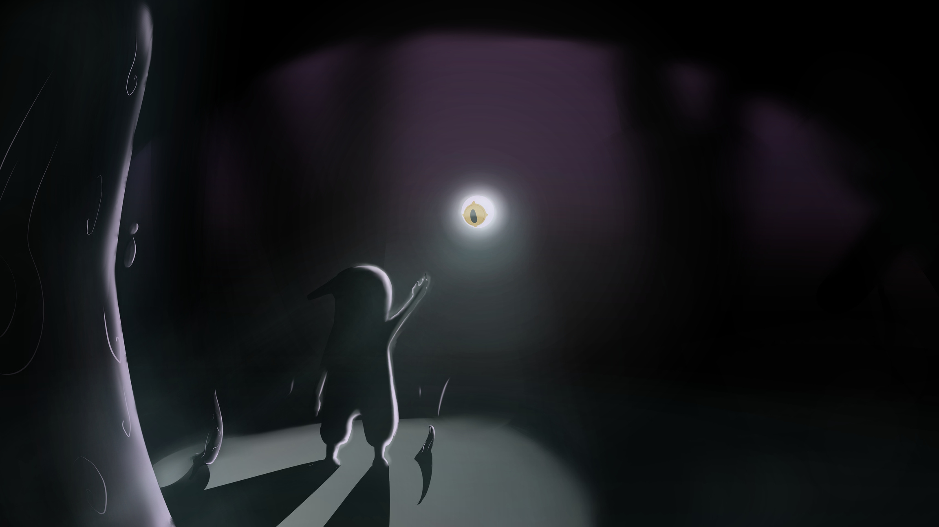



Shadow & Eye
What if the human mind was a deep, intricate eco-system, with every aspect having a physical form and the hard fought battles inside will take place right in-front of your eyes?
Shadow & Eye is a 2D Metroidvania where not only do you fight inner demons, but you ARM yourself with them.
Developers:
Daniel Fradkin
Or Bar-Califa
Animators:
Naor Masri
Majd Francis
Mentoring by Ella Luna Pleasence

Slide 2
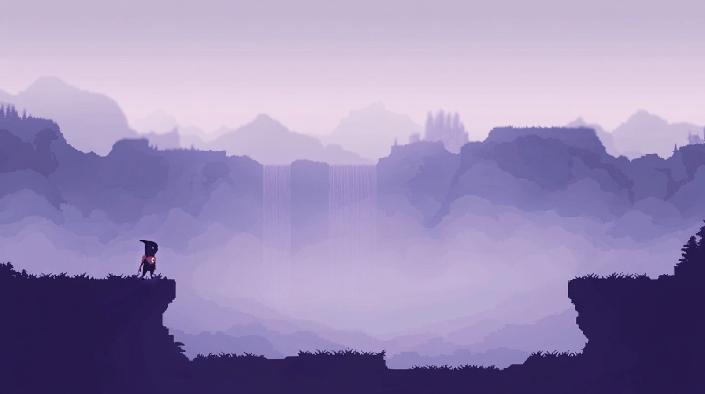

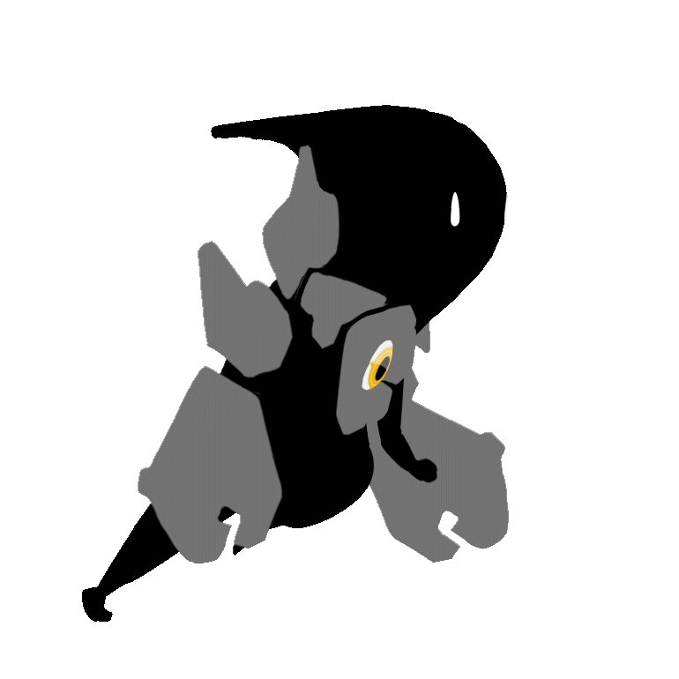
The concept
As a disaster falls upon this world, at your feet arrives “The Eye” - an all-seeing entity, removed and banished from its place.
Your mission is to return it to its place and bring this world back to health.
To traverse this unforgiving land, The Eye grants you the power to wear the shells of the enemies you defeat - ”Maluvestis”, to beat even stronger foes and reach remarkable heights.

Slide 3

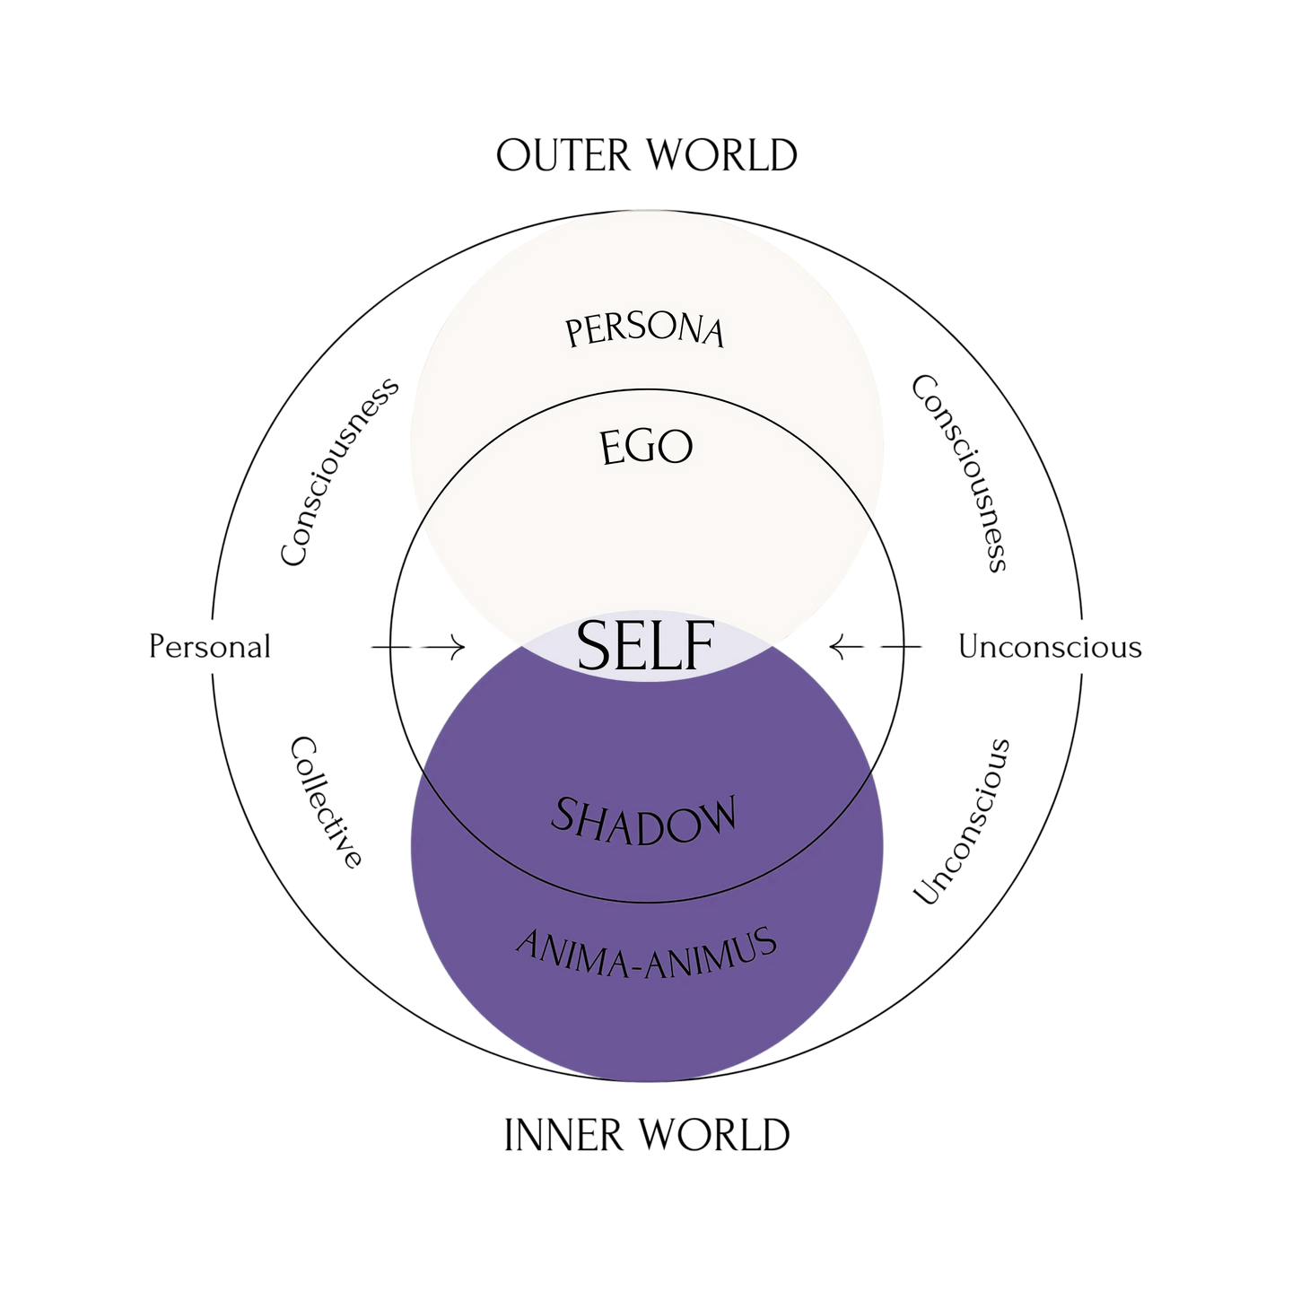



The Theory
THE game
REVELIS
VERONA
VEGO
THE EYE
ADO
EBBA & IMMUS
CALIGOTH

Slide 4
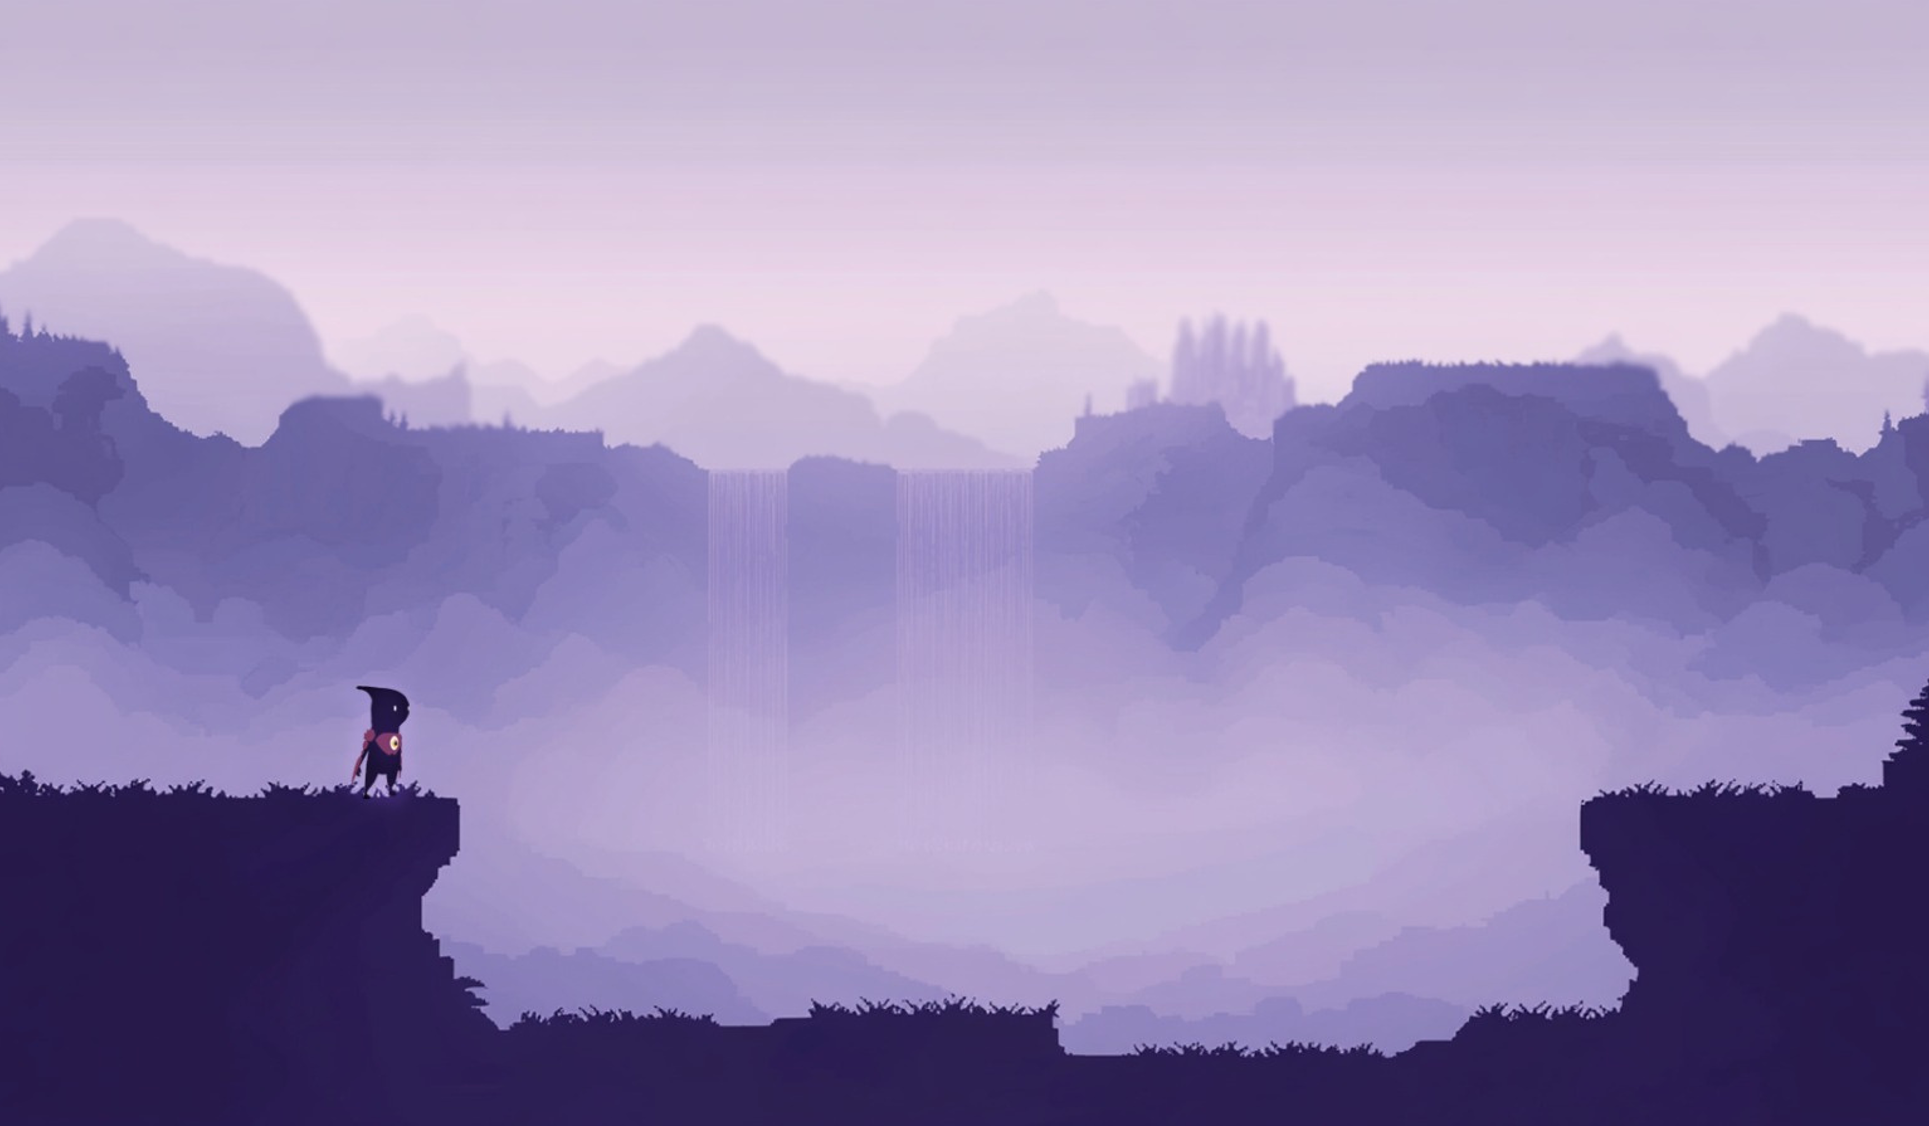
ı
ıı
Project Goals
Fun game exploring self-discovery & inner challenges
Support variety of abilities to allow diverse playstyles
Smooth Combat & Movement: Impactful actions; fluid tactical adaptation; dynamic movement
Support expandability and maintainability of large scaled game with different levels and challenges

Slide 5
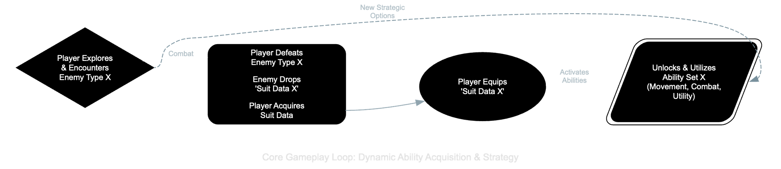
Making it All Happen
Dynamic world with many different levels
Diverse suits and abilities: Handle different kinds of abilities and suits
Quick Power Swaps: Adjust player functionality based on equipped suit
Create distinct behavior for each enemy
System Interplay: Independent yet coordinated game parts
Notes:
Speaker Notes: (You'll deliver this verbally) Of course, we hit some challenges. Like, how do we manage all these unique player powers without the code getting super messy? How do we make switching between powers feel good? How do we make sure the game mechanics actually connect to our deeper themes? And how do we get all the different parts of the game to talk to each other without creating a tangled web?

Slide 6
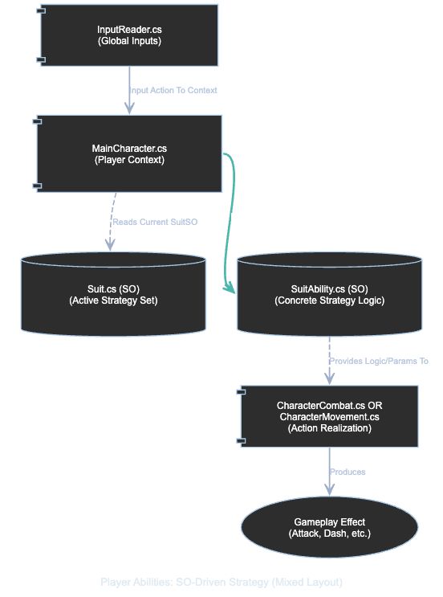
How We Solved It (Part 1): Smart Data & Key Patterns
Foundation: Unity Component-Based
ScriptableObjects (SOs): Data-Driven Core
Suits/Abilities = Configurable SO Data
Add Data, Not Code Bloat
Flexible, Iterative, Thematic Design
Strategy Pattern: Dynamic Player Abilities
Instantly Swap "Game Plans" (via Suit SOs)
Fluid & Adaptive Playstyles
Notes:
Speaker Notes: (You'll deliver this verbally) So here's how we tackled those challenges. Our main trick was using ScriptableObjects a LOT. Think of these as data files that tell the game how abilities work or how enemies should behave. This means adding a new power is mostly like adding a new data file, not rewriting a bunch of code. For player powers, we used the Strategy pattern – which just means the player can easily swap their 'game plan' based on the enemy power they're using.

Slide 7
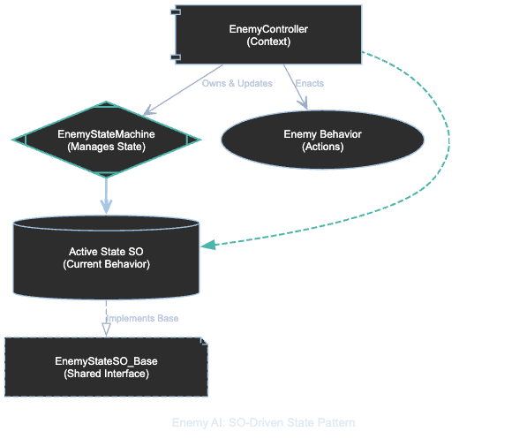
How We Solved It (Part 2): System Flow & Communication
State Pattern: Predictable Behaviors
Enemy AI: Defined States (Idle, Chase, Attack)
Game Flow: Managed States (Menu, Play, Pause)
Organized, Debuggable Complexity
Observer Pattern: Decoupled Communication
Action -> Posts Event (SO "Notice Board")
Systems (UI, Audio) Listen & React Independently
Decoupled, Clean Code, Maintainable
Notes:
Speaker Notes: (You'll deliver this verbally) Enemies and the game's flow use the State pattern, which keeps their behaviors organized. And for getting different systems to communicate, we used ScriptableObject Event Channels – it's like a digital notice board. When something happens, a notice gets posted, and any system that cares can react. This keeps everything nicely separated. Plus, URP helped us make the different 'mind-zones' look cool, and A* makes enemies chase you properly.

Slide 8
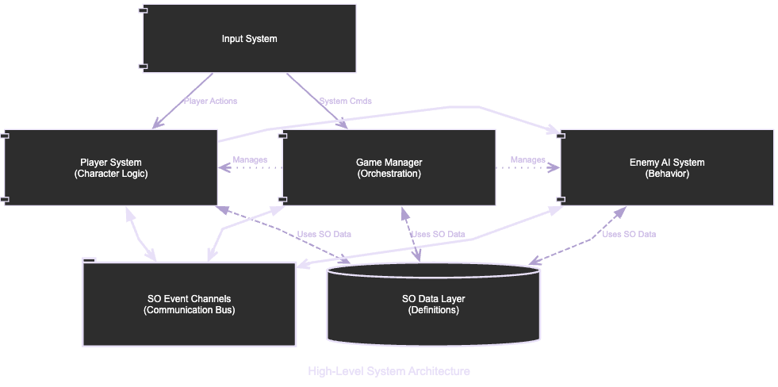
So, Did Our Plan Work?
[IMAGE/GIF: Short GIF showing off a few different cool powers in action]
Added 3 diverse powers; minimal core changes
Smooth performance and game feel
Decoupled system: easier debugging & additions.
Notes:
Speaker Notes: (You'll deliver this verbally) And yeah, this approach worked out pretty well! We were able to add a bunch of unique player abilities without massive headaches, the game runs smoothly, and because our code is organized, fixing things and adding features has been manageable.

Slide 9
The Coolest Part & What's Next
Core Achievements:
Flexible, Data-Driven Systems
Dynamic Player Agency and strategic choices
Exploring Nosfera, acquiring powers, and overcoming challenges
The Road Ahead:
More Suits & Abilities
Evolved "Demons" (Smarter AI/ML, Unique Challenges)
New Zones, Richer Lore, Full Narrative
Enhanced Player Experience (Key Bindings, Save System)
Notes:
Speaker Notes: (You'll deliver this verbally) What we're most proud of is how the game's deep ideas are built right into the gameplay, thanks to our flexible, data-driven systems. For the future, we'd love to add more powers, crazier enemies, new areas of the mind-world to explore, and wrap up the story.

Slide 10

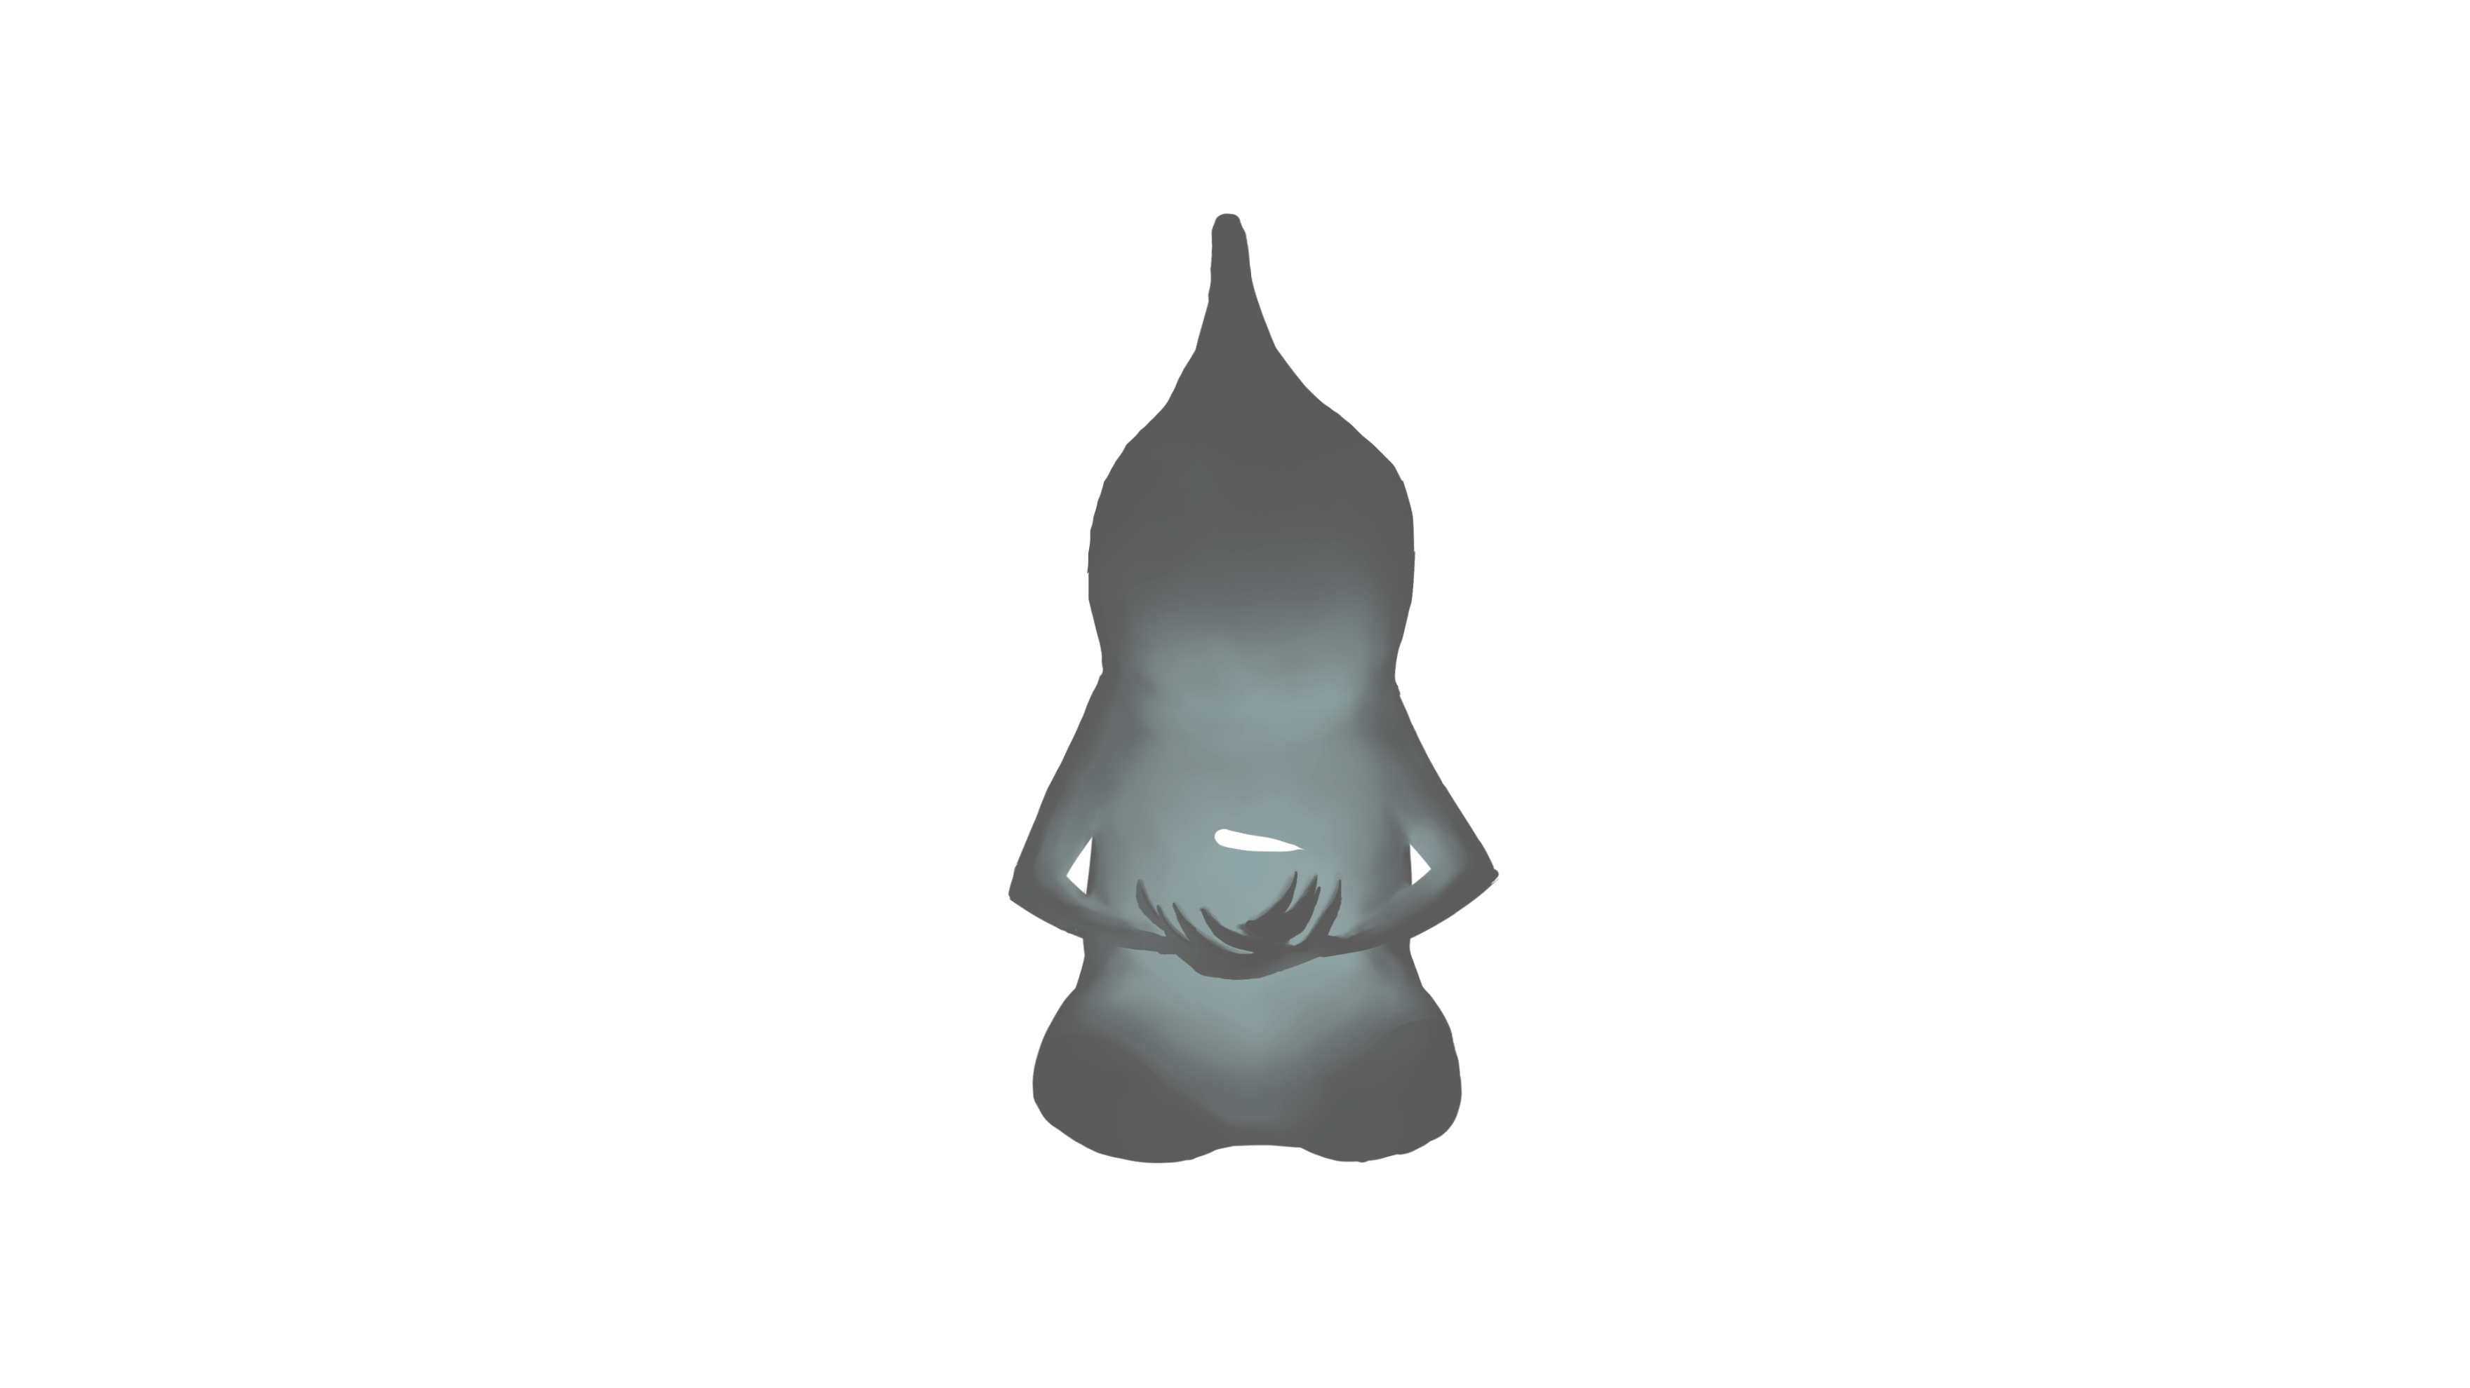


Thanks for listening!
Download Beta at itch.io
Team: Daniel, Or, Naor, Majd
Notes:
Speaker Notes: (You'll deliver this verbally) Thanks for listening! Any questions?

